Slide 1
Impact Analysis: Inpatient Exclusions in the CDR BE Encounter Groups
Chris Amendola
September 2021

Slide 2
Impact: Analysis of Inpatient Exclusions for Non-R&B Encounter Groups
Selected Clients, Key Metrics
Clients
H641171
H406239
H053731
Metrics
Production Vs. Simulation of ‘Excluded’ Encounters
For Years 2018-2021
% Zero-Day Stays
Visualization of Distribution of Frequency of Stay Days
Average Length of stay

Slide 3
Impact: Analysis of Inpatient Exclusions for Non-R&B Encounter Groups
Description of Exclusions logic for Simulation Data
Based on L1_CLIAMs
Determine R&B Status for encounters with claims
Simple Boolean
Encounter ‘has’ R&B, with one or more supporting claims with R&B code
Identify Events with Zero Stay Days, and no R&B encounters
Filter these events from calculations

Slide 4
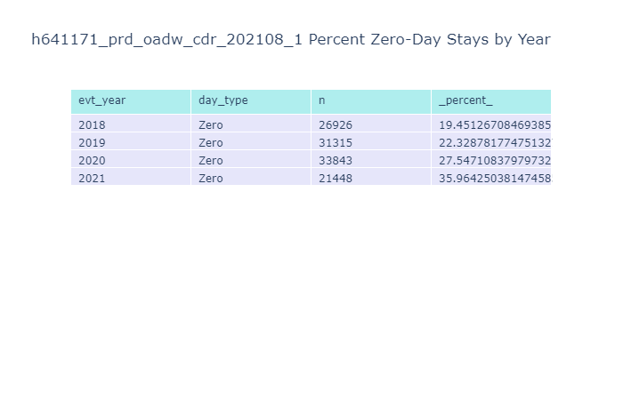
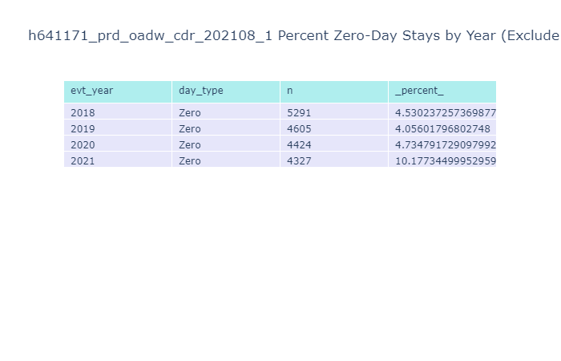
H641171
Exclusion Greatly reduces % Zero Day Stays – still slightly high.

Slide 5
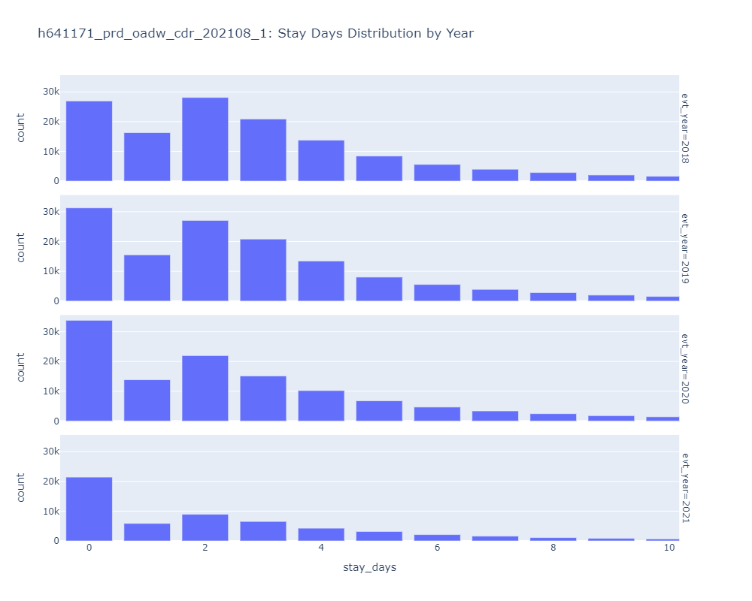
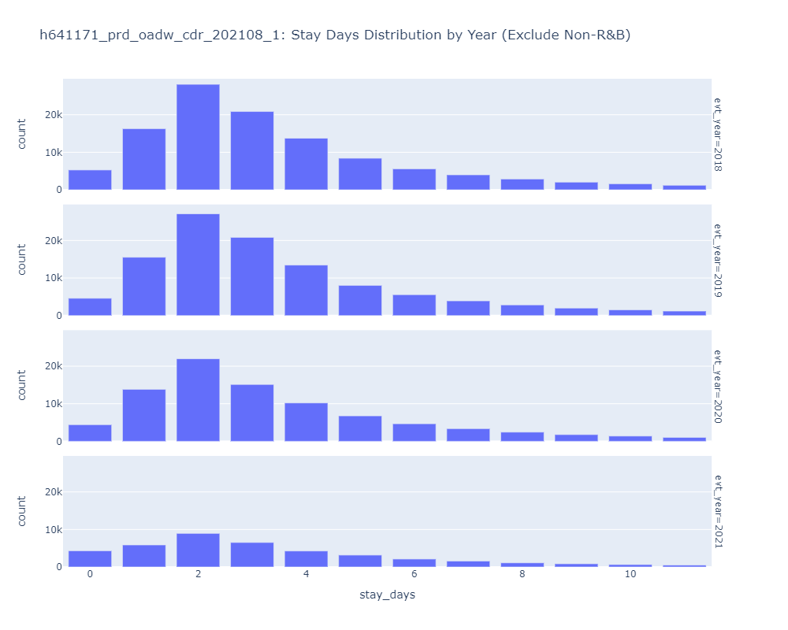
H641171
Exclusion Greatly reduces % Zero Day Stays – still slightly high.

Slide 6
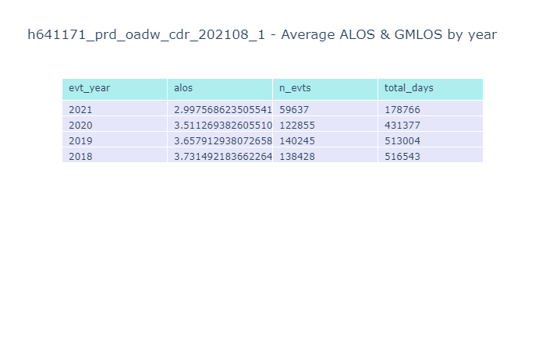
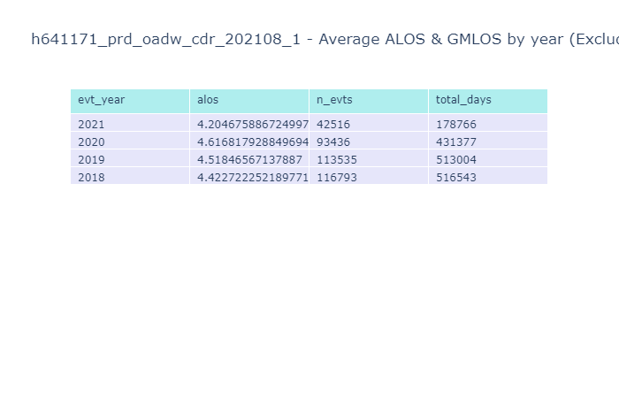
H641171
Average Length of Stay – expected range acheived

Slide 7
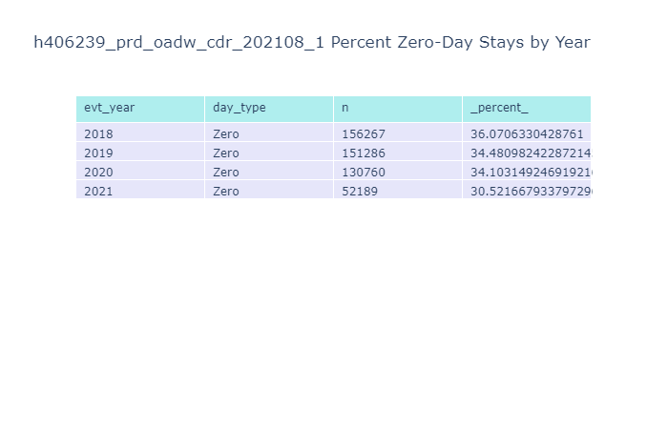

H406239
Mission Accomplished

Slide 8
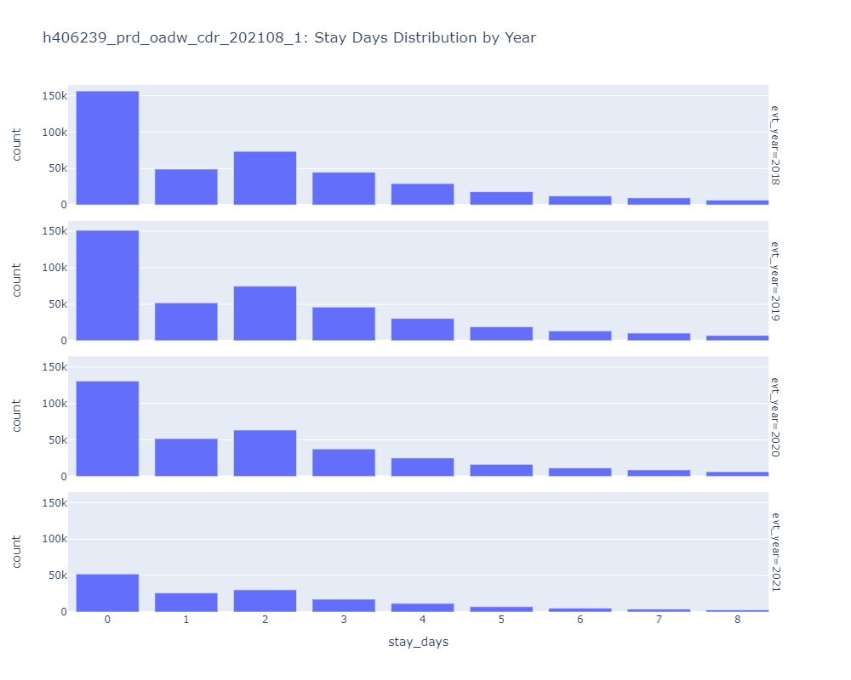
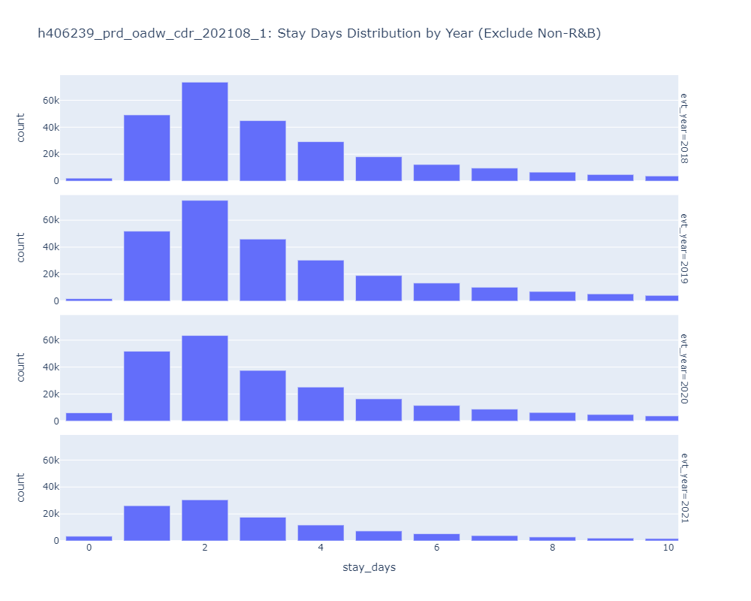
H406239
Mission Accomplished

Slide 9
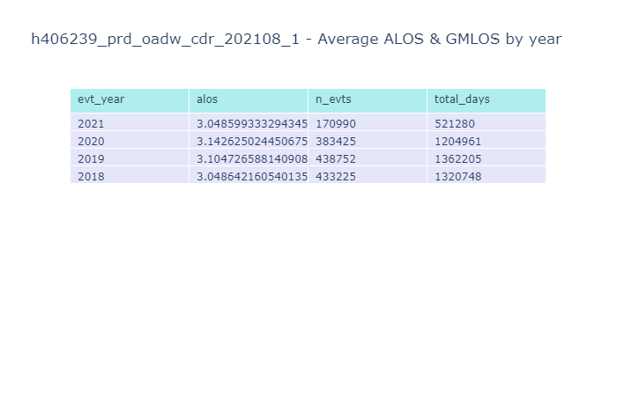
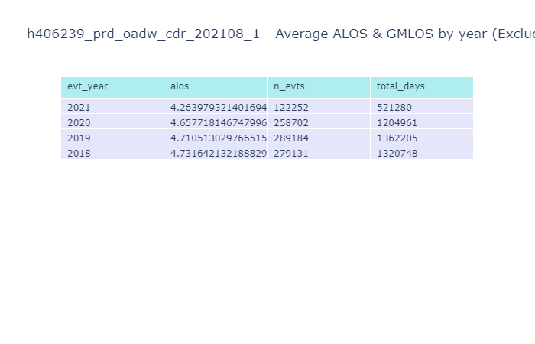
H406239
ALOS appears typical

Slide 10

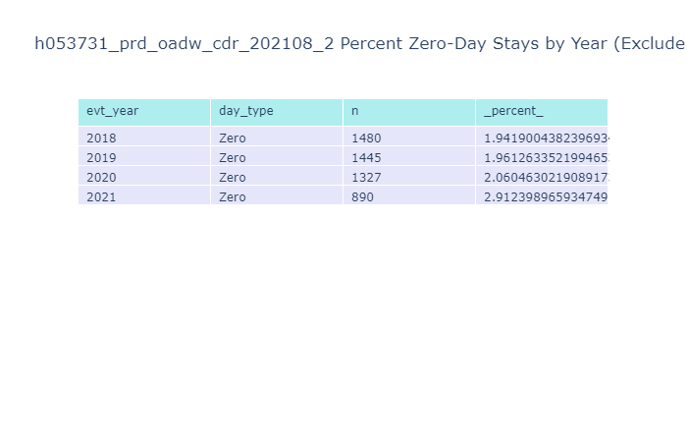
H053731
R&B Exclusion Working as Intended %Zero-Day Stays

Slide 11
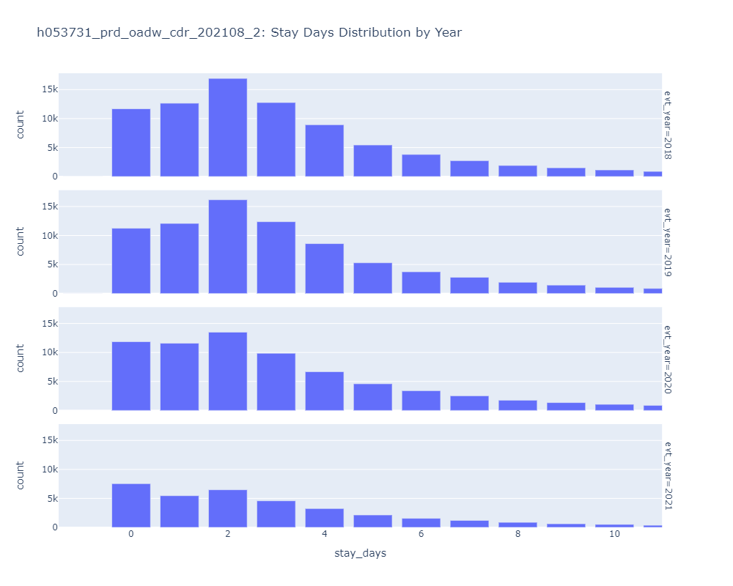
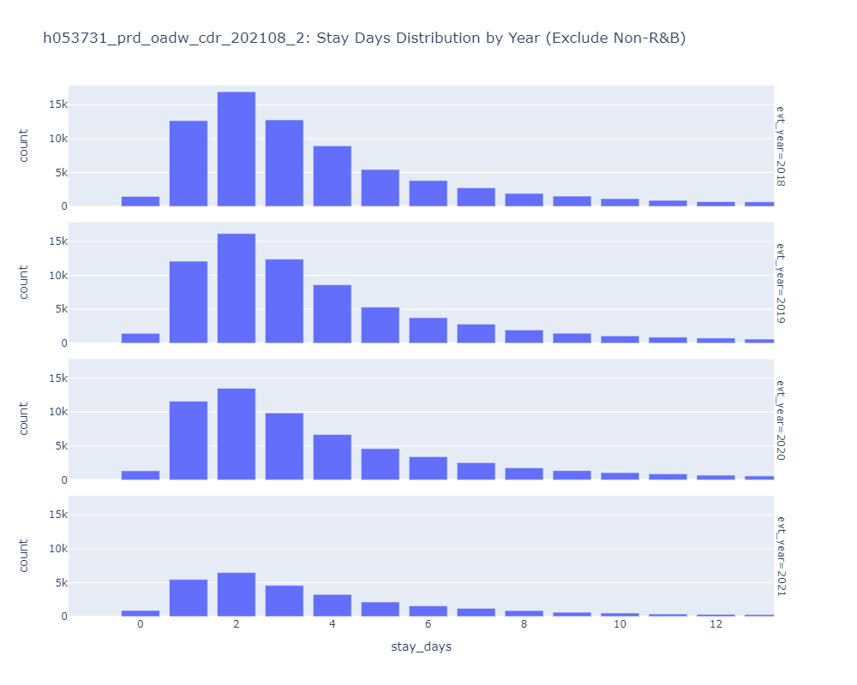
H053731
Exclusion Greatly reduces % Zero Day Stays

Slide 12
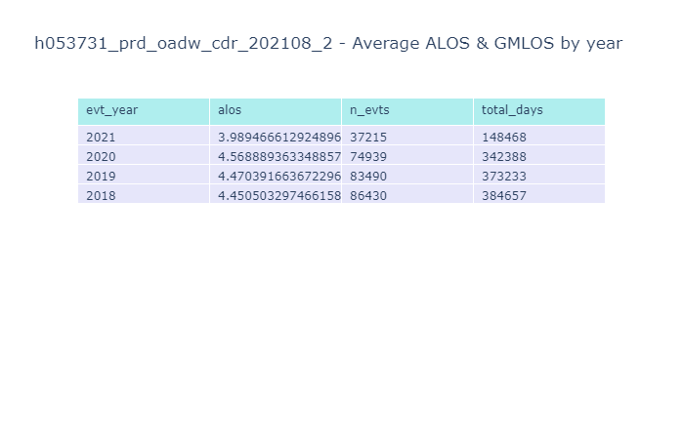
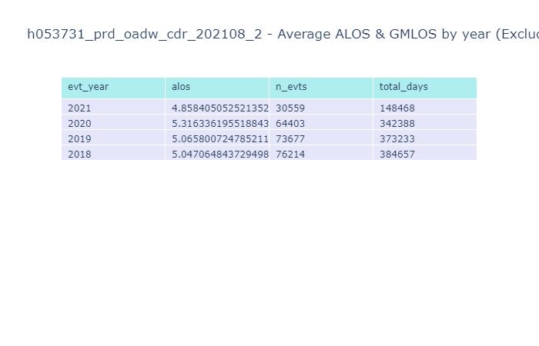
H053731
ALOS appears typical

Slide 13
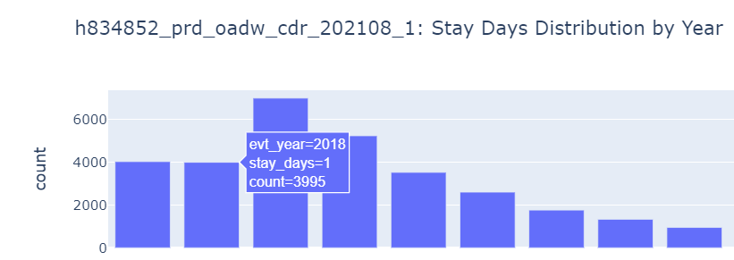
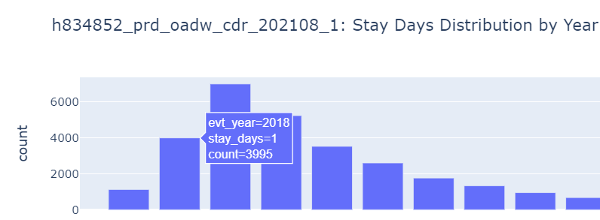
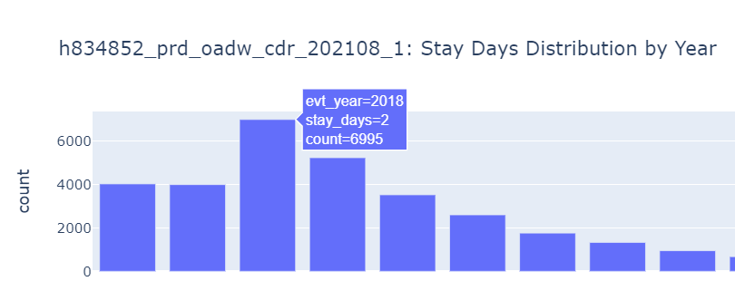
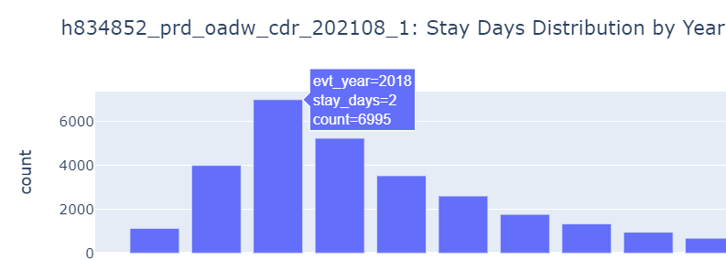
Quick Snapshot
1+ Day Stays Unaffected (1 of 2)

Slide 14
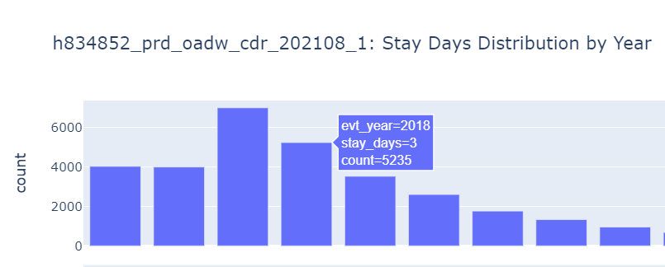
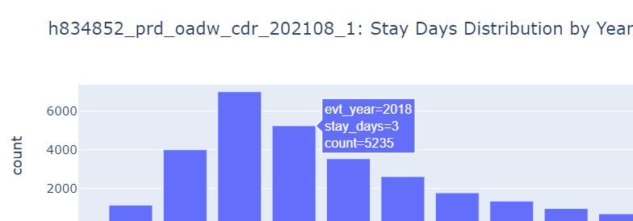
Quick Snapshot
1+ Day Stays Unaffected (2 of 2)

